Slide 1
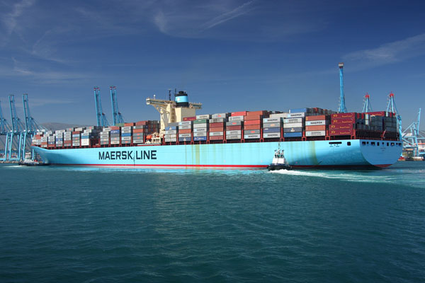
Nomenclatura y estructura náutica(ingles)
Cummings, corina
Davis, Alfredo
Duffies, Gerardo
MITCHELL, rICHARD

Slide 2
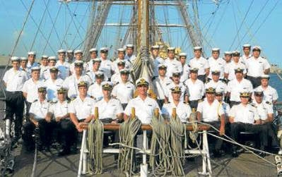
THE CREW
MASTER, CAPTAIN CAPITAN
CHIEF OFFICER, CHIEF MATE - PRIMER OFICIAL, PRIMER PILOTO
CHIEF ENGINEER - JEFE DE MAQUINAS
SECOND ENGINEER - SEGUNDO INGENIERO
THIRD OFFICER, THIRD MATE - TERCER OFICIAL, TERCER PILOTO
THIRD ENGINEER - TERCER INGENIERO
BOATSWAIN, BOSUN - CONTRAMAESTRE
FITTER - REPARADOR
CREW - TRIPULACION

Slide 3
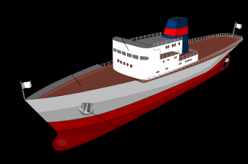
Part of a ship
BOW-PROA
STERN-POPA
STARBORD-ESTRIBOR
PORT-BABOR
DEADWORKS, TOPSIDE - OBRA MUERTA
PORT BOW - AMURA DE BABOR
STARBOARD BOW – AMURA DE ESTIBOR
DEPTH - PUNTAL
DRAFT – CALADO
FREEBOARD - FRANCO BORDO
HAWSEHOLE - ESCOBEN
HULL-CASCO
BULBOUS – BULBO

Slide 4
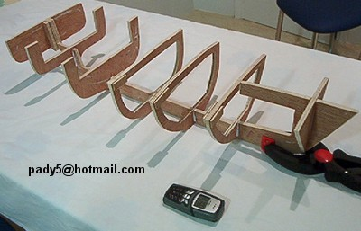
RUDDER- TIMON
FRAME – CUADERNAS
KEEL- QUILLA
STEM-RODA
HACKLE – GRILLETE
SKYLIGHT - LUMBRERA, CLARABOYA
STERN FRAME – CODASTE
CHINE – PANTOQUE
FORE FOOT – PIE DE RODA

Slide 5
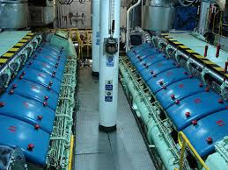
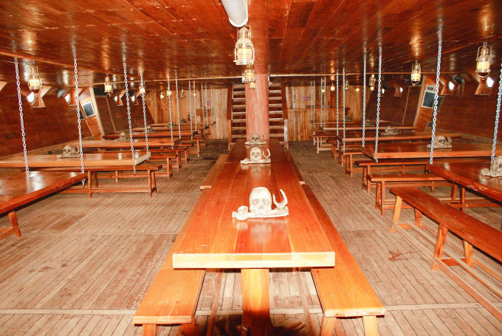
BRIGE- PUENTE
EGINE ROOM-SALA DE MAQUINA
DECK-CUBIERTA
BEAM – MANGA
CENTERLINE – LINEA DE CRUJÍA
LENGTH- ESLORA
LENGTH OVERALL- ESLORA TOTAL
HOLD- BODEGA
LOKER- PAÑOL
MESROOM- COMEDOR
GALLEY-COCINA

Slide 6
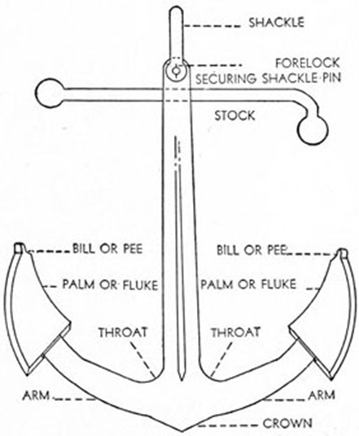
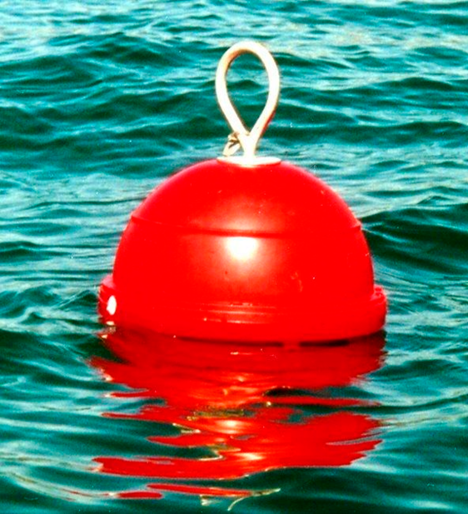
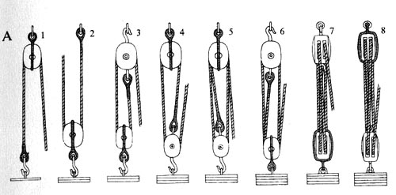
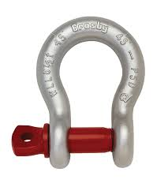
ANCHOR-ANCLA
CRANE-GRUA
BUOY-BOYA
CABIN- CAMAROTE
PIER-MUELLE
TACKLE-APAREJOS
CHAIN-CADENA

Slide 7
basic nomenclature
SAFETY -SEGURIDAD
DANGER -PELIGRO, RIESGO
CAUTION- CAUTELA, CUIDADO
NO SMOKING -NO FUMAR
RISK -RIESGO
HEALTH -SALUD
EXPLOSION-PROOF A PRUEBA DE EXPLOSION
EXTINGUISHER -EXTINTOR
FIRE -FUEGO, INCENDIO
FIRE -ALARM ALARMA DE INCENDIO
GRAVING-CARENADO
BALE OUT-ACHICAR
ABANDON SHIP- ABANDONAR

Slide 8
TYPES OF SHIPS

Slide 9
Buques Petroleros (Crude oil Carriers)

Slide 10
Buque Portacontenedores (Container Ship)

Slide 11
Buques Químicos (Chemical Tankers)

Slide 12
Buque Gasero (L.N.G. Carrier)

Slide 13
Buque carga a granel (Bulk Carrier)

Slide 14
Roll On / Roll Off Cargo (RoRo)

Slide 15
Remolcadores (tugboats)

Slide 16
-Manual of semanship vol. 1951 -The marine encyclopadeic Dictionary (ingles- Español) -English-Spanish Glossary-Nautical-Terms

